Slide 1
In close
cooperation
Pieter Baerts & Wim Lens Seminar PXL - Agile Testing
17-05-2022

Slide 2
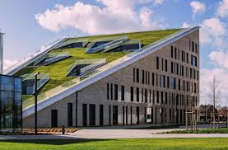
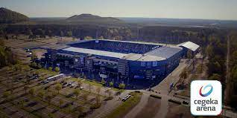
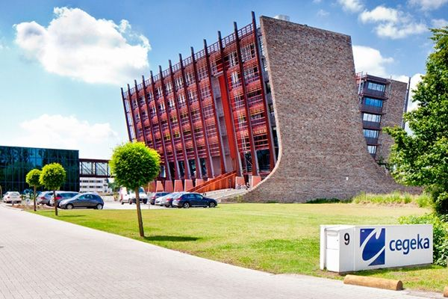

Slide 3

Facts & figures
640 Mio EUR
turnover in 2020
+ 2500
happy customers
+ 5000
engaged employees (2020)
1992
Founding date of our family-owned company
10+
2
Offices in
European countries
high performance and
redundant data centers
Notes:
[Talking Points]
In 2020, our turnover figure amounted to 640 million euro
We service over 2500 happy customers in 10+ countries worldwide; we also have 2 Cegeka-owned high performance data centers
We are a family-owned company, founded by our former CEO André Knaepen in 1992
Over the past 29 years, the company has grown, from 25 people to more than 5.000 employees

Slide 4
A European IT solutions provider
1. HQ
3. Region East
Belgium
Hasselt (HQ + data center)
Leuven
Brussels
Antwerp
Ghent
Liège
Braine l’Alleud
Luxembourg
Weiswampach
Luxembourg
Romania Bucharest
Iaşi
MoLdOva
Chișinău Czech Republic
Prague
Olomouc
slovakia
Bratislava
2. Region North
4. Italy
The Netherlands
Veenendaal
Eindhoven Geleen (data center)
Zoetermeer
Groningen
Utrecht
Germany
Munich
Frankfurt (Neu-Isenburg)
Cologne
Nuremberg
Austria
Vienna
Neulengbach
Graz
Sweden
Linköping
Luleå
Stockholm
Milan
Gallarate
Padua
Rome
5. Outside Europe
U.S.
Greenville (South Carolina)
Notes:
[Talking Points]
As you can see, we truly are a European ICT integrator, present in 11 European countries. We also have 2 data centers: one in Belgium (Hasselt), one in the Netherlands (Geleen).

Slide 5
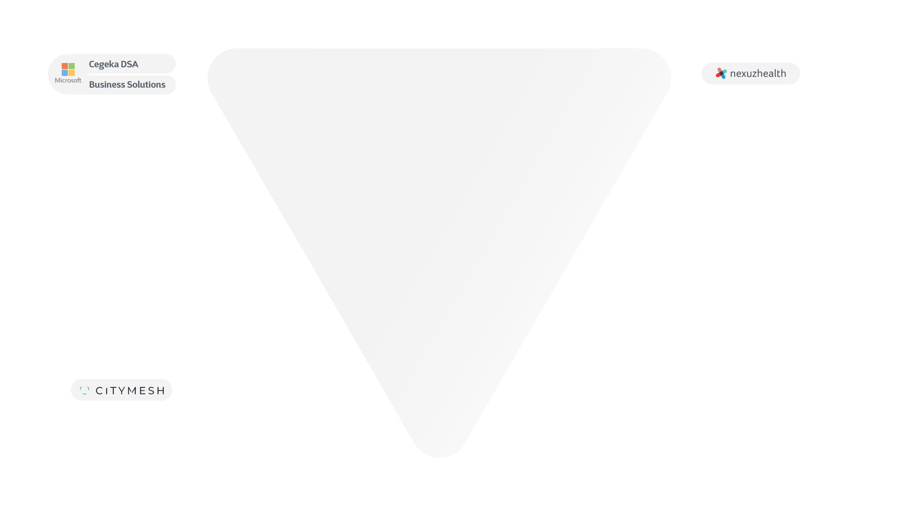


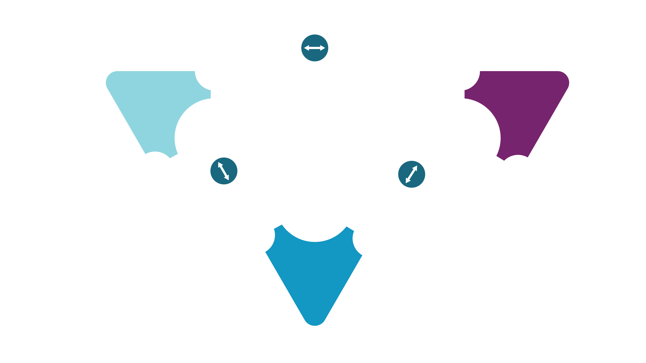





Our market
approach
Cegeka Business Solutions
Business Intelligence
Connected Health
Data Science
Data
Applications
Smart Industries
Data Engineering
Smart Services
Social Impact
Data Governance
Smart Cities
Flanders Digital
Infrastructure
Cyber Security
Digital Workplace
Cloud Enablement
Notes:
Talking Points
Slide Market Approach
In line with our ambition to be a trusted advisor for out clients we developed the Cegeka organization around the Data - Applications - Infrastructure activities.
These three business lines are strongly interconnected, ensuring strong mutual cooperation and a shared market approach. In addition, we are positioning so-called subsidiaries within the Cegeka Group, which operate with more autonomy, and are characterized by specific market approaches, expertise and business models:
Citymesh is the Cegeka Group's specialist for mobile connectivity solutions in the business-to-business market.
Nexuzhealth develops specific solutions for the healthcare sector.
Cegeka Business Solutions (an integration of Business Solutions and cegeka-dsa) is our European Dynamics House, the Cegeka Microsoft partner for D365.

Slide 6
Agile Testing

Slide 7
Github
github.com/wimlens/agileTesting

Slide 8



Slide 9
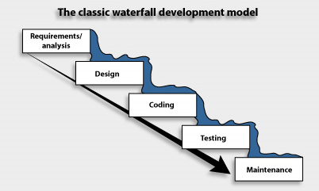
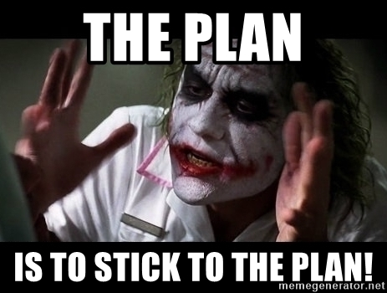
Waterfall

Slide 10
Agile

Slide 11
Build the right thing
Build the thing right
Build it fast
Notes:
Build the right thing: juiste dingen maken om business impact te hebben terwijl er altijd meer kan gebeuren dan dat er tijd of budget is – terwijl je niet op voorhand weet wat de impact zal zijn van iets wat je bouwt op je business
Build the thing right: TDD, definition of done,
Build it fast: potentially shippable product

Slide 12


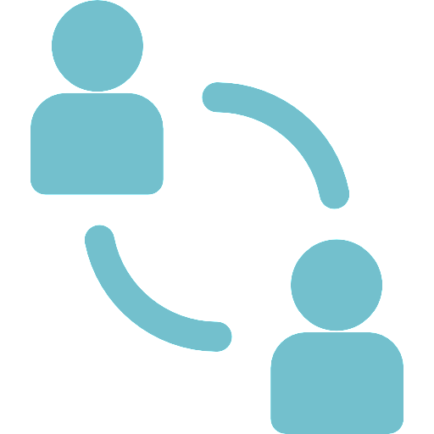


Manifesto for Agile Software Development
We are uncovering better ways of developing software by doing it and helping others do it.
Through this work we have come to value:
Individuals and interactions over processes and tools
Working software over comprehensive documentation
Customer collaboration over contract negotiation
Responding to change over following a plan
4 Values
Excerpted from: agilemanifesto.org
Notes:
Lore
Trainer Guidance:
In the 1990s, responding to the many challenges of waterfall processes, some lighter-weight and more iterative development methods arose. In 2001, many of the leaders of these frameworks came together in Snowbird, Utah. While there were differences of opinion on the specific merits of one method over another, the attendees agreed that their shared values and beliefs dwarfed the differences. The result was a Manifesto for Agile Software Development, a turning point that clarified the new approach and started to bring the benefits of these innovative methods to the whole development industry.
That was the Lean, now let’s look at Agile. It was that Agile Manifesto that kick-started this. It’s absolutely imperative that the organization understands and embraces ALL of this. If they don’t, we simply can’t go forward with anything until they do.

Slide 13
12 Agile principles
early and continuous delivery
welcome change
deliver software frequently
business + developer
trust
face-to-face conversation
measure of progress = working software
constant pace
technical excellence
simplicity
self-organizing teams
retrospect and tune
Notes:
Lore (Frank start breakout rooms) -> Elke (volgende slide)
Deze 12 principes worden gevolgd om values tot stand te brengen en te concretiseren.
Discussie in groepjes van 3-4
Vraag: Welke van deze principles herken of heb je vandaag NIET in je project en zouden een meerwaarde kunnen betekenen? Komen er principles terug?
Nadien 1 afgevaardigde kan principes komen toelichten
Discussie in groepjes per 2-3 (2-3 principles bespreken): Wat betekent dit voor u? Hoe zie je dit (niet) in je huidige/vorige project?
Eerst hebben we dit na de discussie in een breakout room, laten voorbrengen. Blijkt dat dit te veel tijd in beslag neemt. Onze volgende aanpak zou zijn: discussie in kleine groepjes, daarna kort zelf even overlopen.
Simplicity: KISS (Keep It Short & Simple)
Some principes, highlights that we haven’t dealt with yet
Focus on software development: deliver software frequently, business + developers, measure of progress = working software, technical excellence

Slide 14
Scrum

Slide 15
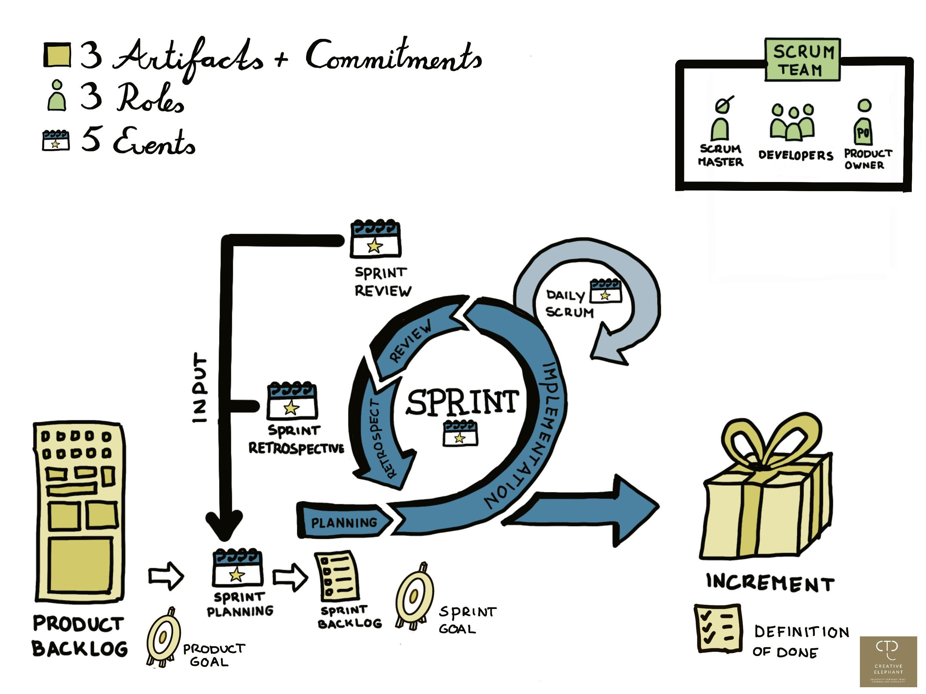
Scrum
Notes:
Elke
Slides toevoegen met afbeeldingen over de verschillen
Verder in de training verdiepen in scrum

Slide 16

Why agile?
Notes:
Elke
Why Agile?
Ben je al overtuigd van de voordelen of nog niet helemaal?
Reageer met hart, …
Reageer met verbaasde emoticon
Steek je hand op als je nog een vraag of aanvulling hebt

Slide 17
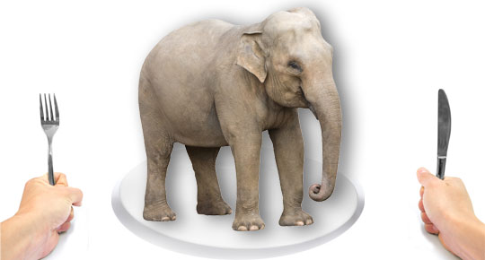
How do you eat an elephant?
Notes:
How to eat an elephant or: how to tackle a big project
Sight of a big project / goal seems impossible to achieve Feel overwhelmed
Answer: one bite at a time
Every bite = tiny success > reason to celebrate
Enjoy the process = important
Take action, no matter what happens

Slide 18
Slicing via component?
User interface
Back-end
Database
Notes:
If we first develop UI, but we don’t have a back-end, we cannot release our software
If we first deliver our back-end, but we don’t have a UI, we cannot release our software
If we have a database, but we don’t have a UI, we cannot release our software

Slide 19

Slicing
Notes:
Need to know
End to end slicing
We want a bite of every filling
All layers should be included in one bite

Slide 20
Slicing
User interface
Back-end
Database

Slide 21
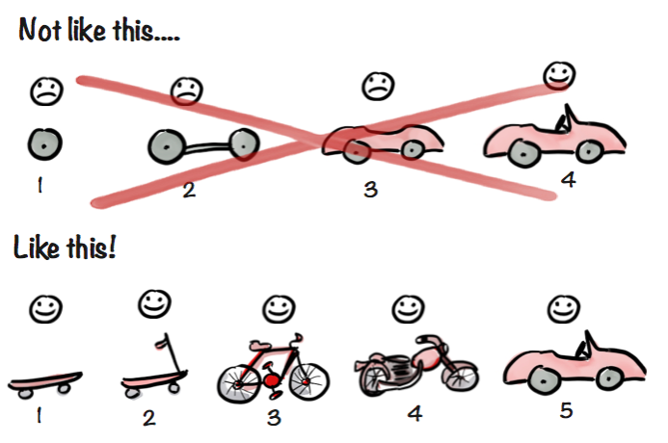
Incremental iterative development
Notes:
Elke
PRODUCT Increment. Bij iedere release moet er een werkbaar product klaar staan.
Manier om zich van A naar B te verplaatsen
Basis verplaatsing met skateboard -→ luxe sjieke auto

Slide 22
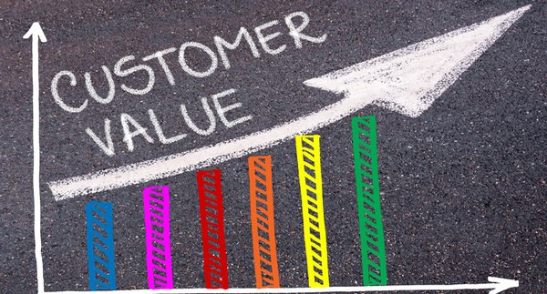
Value is key
Notes:
Elke
einddoel

Slide 23
Agile Testing

Slide 24
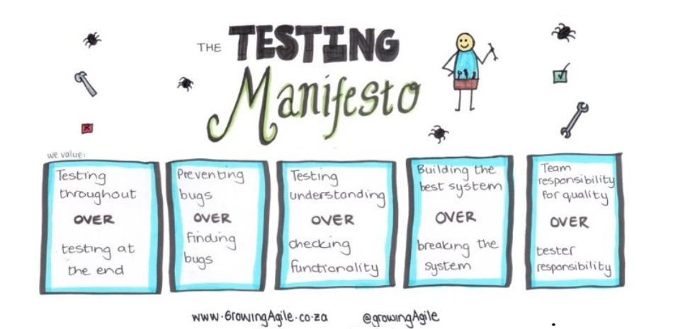

Slide 25
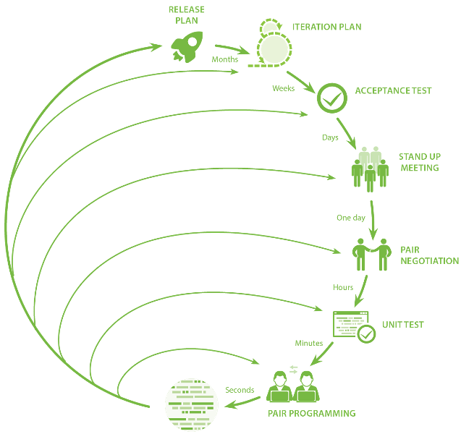
Constant feedback
Feedback loops originally
from extremeprogramming.org

Slide 26
TDD

Slide 27
Why write tests?

Slide 28
Why write tests?
Prove correctness of code
Give quick feedback
Be a safety net that takes away our fear of change
Form an executable and always up-to-date documentation

Slide 29
Why write tests first?

Slide 30
Why write tests first?
Force us to really consider what needs to be done
Verify that the test tests what you want to test because it will fail first
Make you think from the perspective of someone that will use your code
Influence your design by pushing you to write testable code
Notes:
1.Requirements are nailed down firmly by tests.
2.If the test is green before you write implementation, the test is wrong
3.Yup. By writing tests first, your code will naturally conform to an API. Instead of only the perspective of the problem solver
4.Write code that is “testable by design”. Not all code is equal when it comes to how easy it is to test. Write your code from in the beginning so that it can be easily tested. Don’t postpone it to the end!

Slide 31
What is a good test?

Slide 32
Automated
Self-validating
Fast
Focused
A GOOD TEST
Readable
Independent
Maintainable
Repeatable
Notes:
Fast: we want to run the tests frequently
Independent: tests should not depend on each other. In any order you like! = diagnostic difficult when one test makes other test fail
Repeatable: should work all the times, not 9 out of 10. If test fail randomly and the code is 100% surely correct, then just like any signal that gives false alarm you will start ignoring it.
Self-validating: Tests should have a boolean output: Either they fail or they pass. >No log files
Focused: only test a single aspect per test
Readable: remember that tests document the code. Therefore it is also important to have them readable, so that someone who wants to see how a piece of code works, can quickly deduce it from reading the tests. Reading the tests should be enough for someone who wants to use your piece of code!
Maintainable: tests must be just as maintainable as production code. Don’t believe that you will never need to refactor your test code! Quite the contrary, test code is just as important as production code!

Slide 33
Test-driven development
Write test
Run test
Write code
Run test
Refactor
Notes:
* Write a test: this is an automated, repeatable test (using a jUnit style framework)
Run test: it is red… ánd because of the correct reasons
Write just enough code to pass the test (limit scope) – this ensures a good coverage of your code
Run test to see if it works
Refactor code/test if necessary, use tests as safety net
* Repeat entire cycle again and again

Slide 34
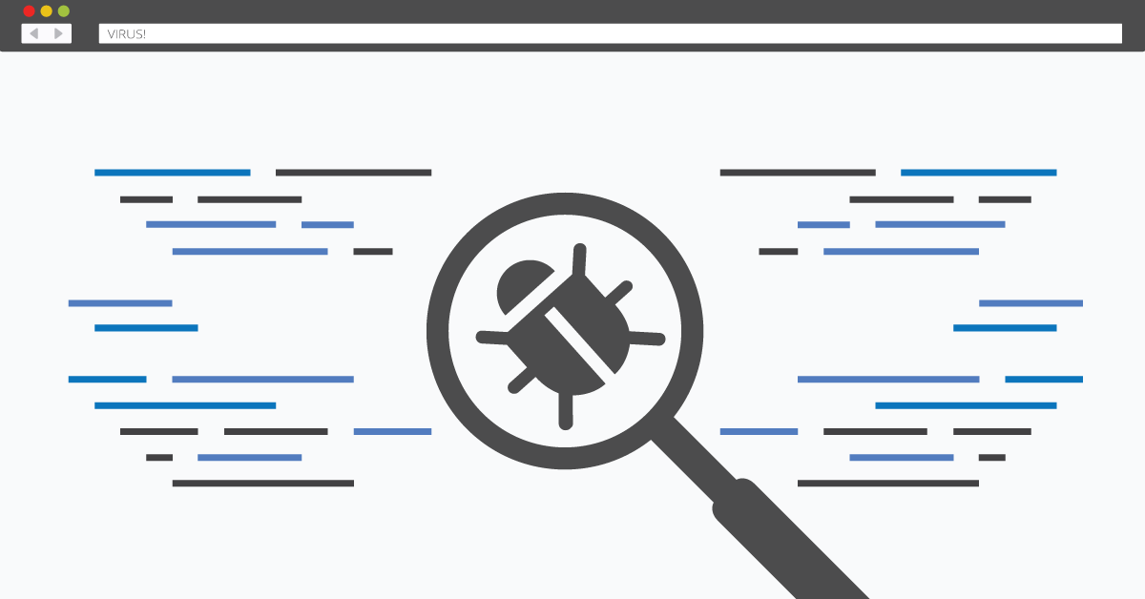
Bugfix exercise
Notes:
Vampires can hunt at 6 o clock

Slide 35
Types of tests

Slide 36
Types of test
Unit tests
Test a small unit of code
Integration test
Do major parts of the application work?
End-to-end tests
Validates whether system works from start to finish
Notes:
Vampires can hunt at 6 o clock

Slide 37
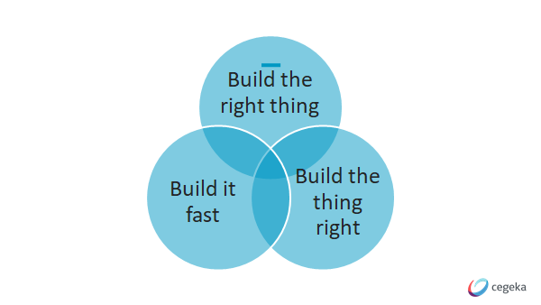

Slide 38
BDD

Slide 39
BDD
Behaviour Driven Development
map business requirements
that make developers and business analysts understand the problems to solve
main goals of BDD is to get people to talk to each other
Notes:
Vampires can hunt at 6 o clock

Slide 40
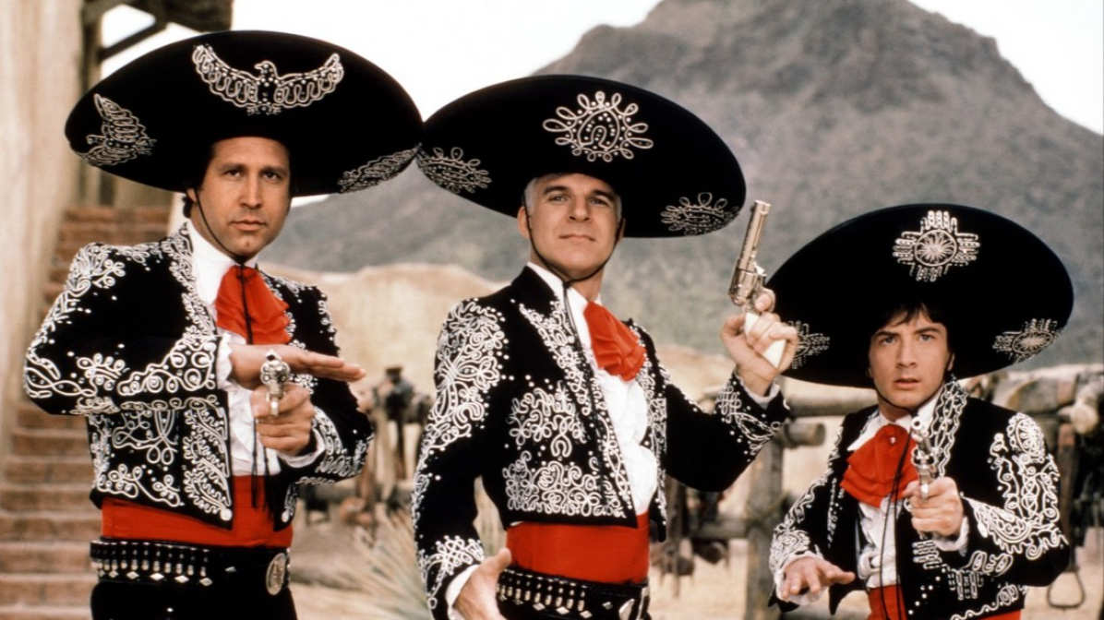

Slide 41
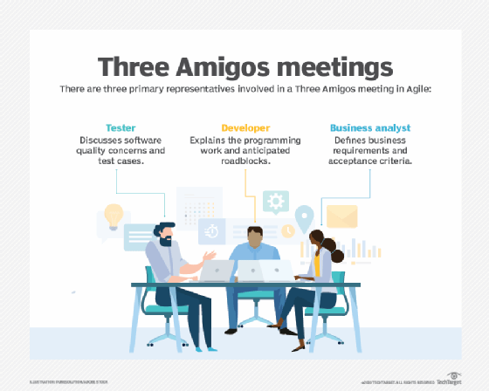

Slide 42
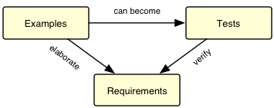
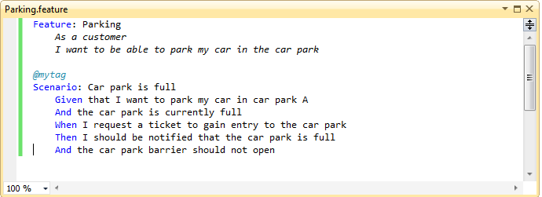
(Automated) Acceptance Tests
More than tests: living documentation
Start from specific real-life examples
In the language of the user

Slide 43
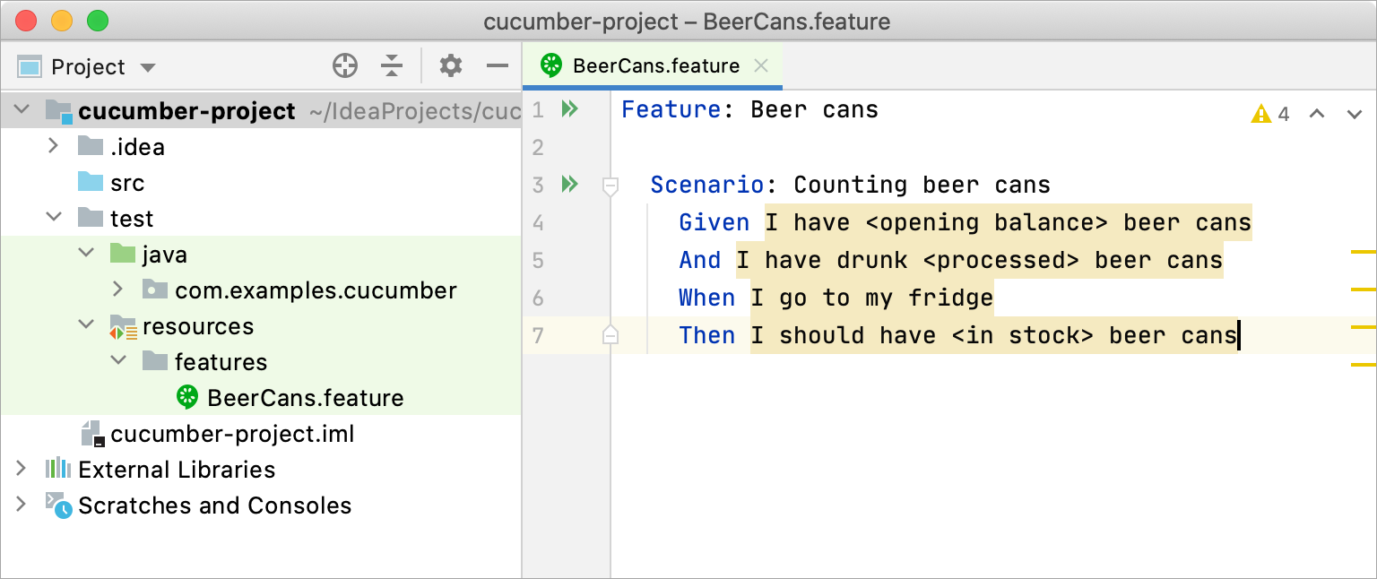
BDD
Notes:
Vampires can hunt at 6 o clock

Slide 44
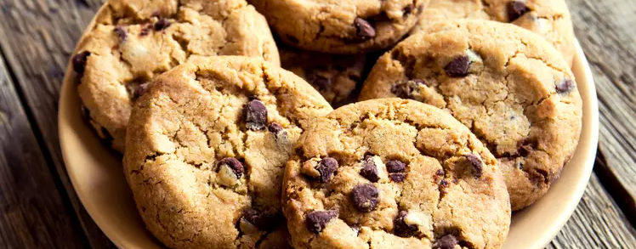
BDD
Exercise
Notes:
Belly growling exercise

Slide 45
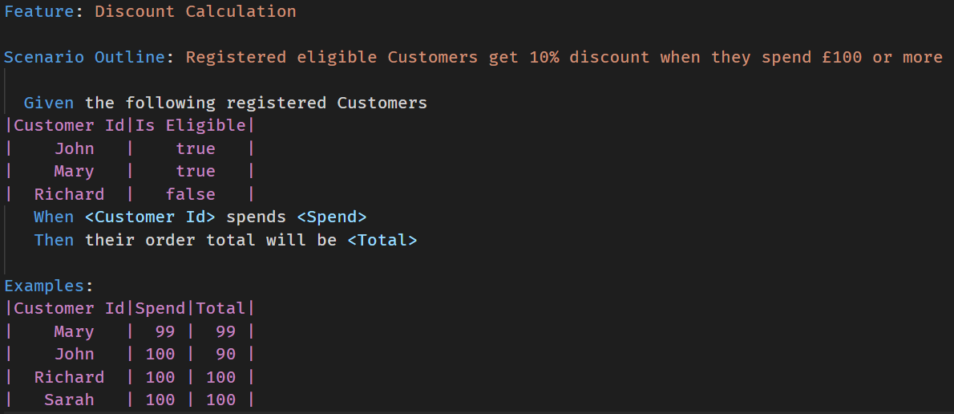
BDD
Notes:
Vampires can hunt at 6 o clock

Slide 46
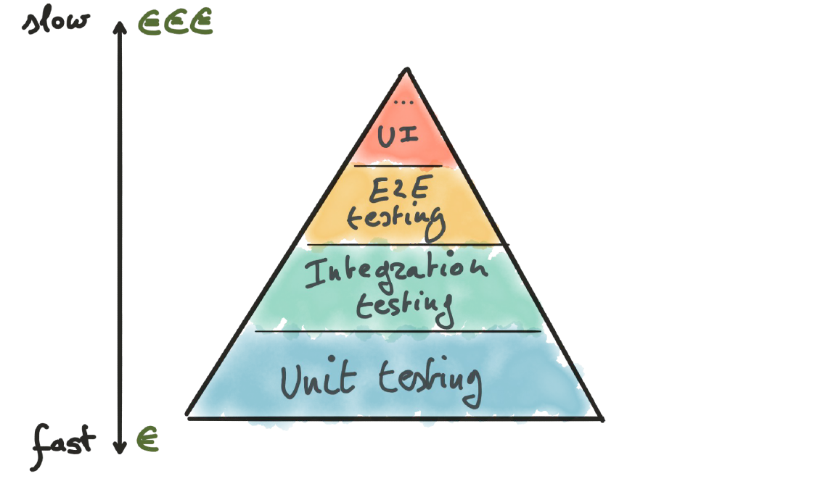
Balance between tests – TDD
Notes:
Proportions of the needed test for TDD.

Slide 47
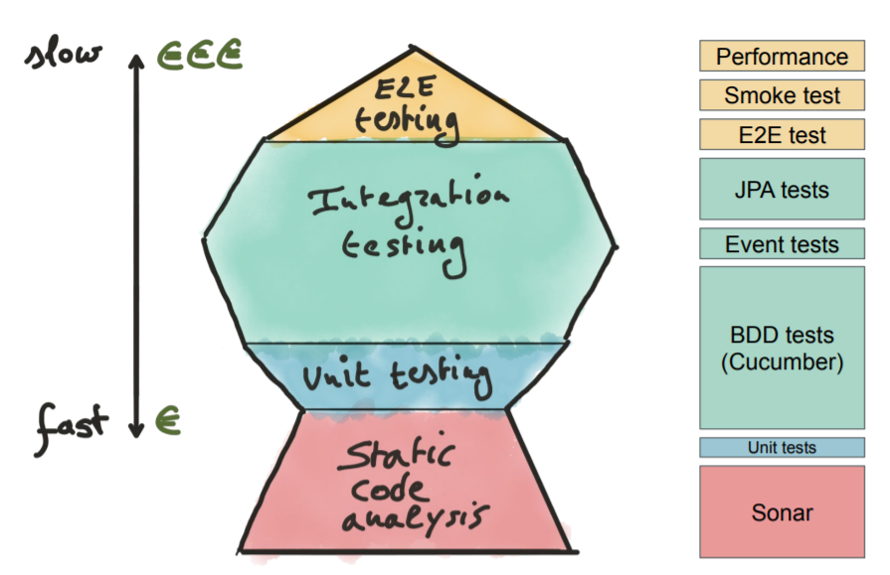
Balance between tests - BDD
Notes:
Sidenote: in BDD less unit tests and more integration tests. So there are alternatives for the pyramid. Just make sure you have sufficient tests.

